Slide 1
IT 1107 Mathematics for IT
Week 8 - Matrices

Slide 2
Transpose of a matrix
A matrix which is formed by turning all the rows of a given matrix into columns & vice versa.
In other words M^{T} _{ij} = M_{ji}
Transpose of a matrix M is denoted by M^{T} or M’

Slide 3

eg: if A = $\left[\begin{matrix}1 & 2 & 3 \\ 4 & 5 & 6 \\ 7 & 8 & 9 \\ 10 & 11 & 12\end{matrix}\right]$
A^{T} = $\left[\begin{matrix}1 & 4 & 7 & 10 \\ 2 & 5 & 8 & 11 \\ 3 & 6 & 9 & 12\end{matrix}\right]$

Slide 4
For vectors transposition turns row vector into column vector and vice versa
(M^{T})^{T} = M for a matrix M of any dimension
D^{T} = D for any diagonal matrix D including the identity matrix I
For a symmetric matrix M^{T} = M

Slide 5
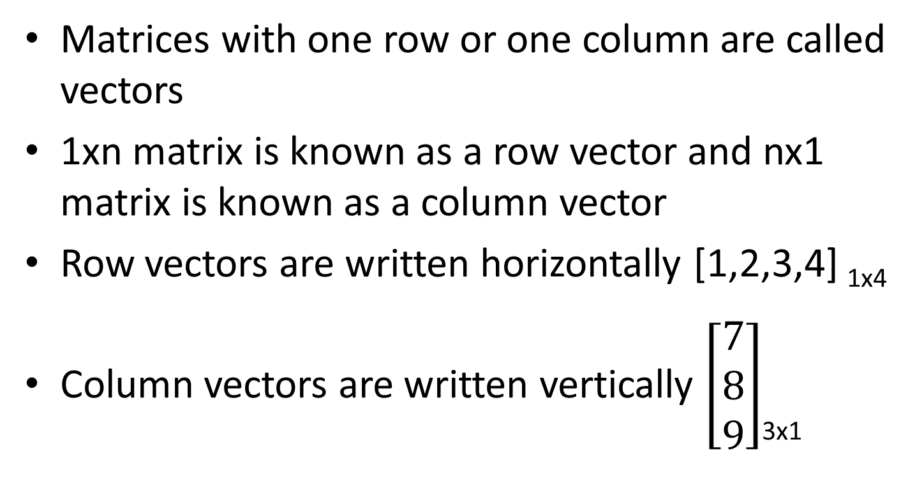
Vectors
Matrices with one row or one column are called vectors
1xn matrix is known as a row vector and nx1 matrix is known as a column vector
Row vectors are written horizontally [1,2,3,4] _{1x4}
Column vectors are written vertically $\left[\begin{matrix}7 \\ 8 \\ 9\end{matrix}\right]$_{3x1}

Slide 6
Matrix Equality
For two matrices to be equal, they must have
The same dimensions.
Corresponding elements must be equal.
In other words, say that A_{n x m} = [a_{ij}] and that B_{p x q} = [b_{ij}].
Then A = B if and only if n=p, m=q, and a_{ij}=b_{ij} for all i and j in range

Slide 7
Matrix operations

Slide 8
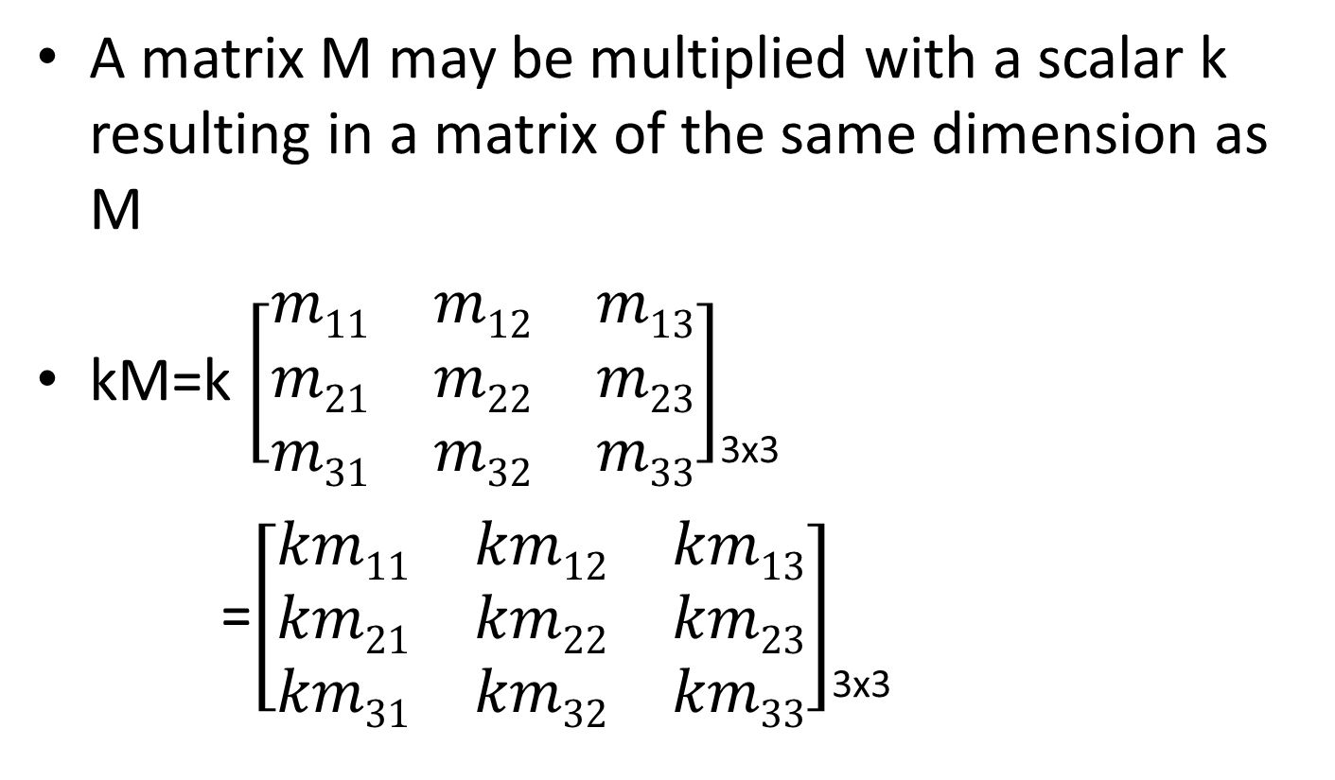
Multiplying a matrix with a scalar
A matrix M may be multiplied with a scalar k resulting in a matrix of the same dimension as M
kM=k $\left[\begin{matrix}m11 & m12 & m13 \\ m21 & m22 & m23 \\ m31 & m32 & m33\end{matrix}\right]$_{3x3}
=$\left[\begin{matrix}km11 & km12 & km13 \\ km21 & km22 & km23 \\ km31 & km32 & km33\end{matrix}\right]$_{3x3}

Slide 9
Addition & Subtraction of matrices
The simplest operation acting on two matrices is addition
Addition of the matrices A & B is written as A+B and defined by
A+B=[a_{ij}+b_{ij}] for all i and j in range
For subtraction replace “+” with “-”

Slide 10
Matrix addition is commutative
A+B = B + A
Matrix addition is associative
A+ (B+C) = (A+B) + C

